Slide 1
CCCA General Meeting Agenda-January 19, 2022
7:00-7:20 pm Business Meeting:
2022 CCCA Officers
Announcements
Brief overview of current development
7:20 – 8:20 pm What is the Future for Route 1? VDOT Senior Project Manager Dan Reinhard will provide an updated timeline for Phase 2 and a Livability22202 panel will respond with neighborhood residential reaction and comments.
8:20-8:45 pm Carol Layer, Director of the DHS Behavioral Healthcare Division on County Mental Health Services.
8:45-9:00 pm Open Forum
Meeting Rules:
Keep video and mike off unless called on to speak
Put questions and comments in the Chat; Raise hand if you wish to speak
Please be respectful and courteous to all participants.

Slide 2
CCCA 2022 Officers
President: Eric Cassel (new)
Vice President: Tarsi Dunlop (new)
Meeting Secretary: Alistair Watson (new by appointment)
Communications Director: Idris Clay
Membership Liaison: Emily Norton
Treasurer: Steve Miller (new)

Slide 3
Announcements
New President of the Crystal City Citizens Review Committee (CCCRC) Mike Dowell
Seeking Community Input on CCCA: Please enter ideas in the Chat box during the meeting with any ideas for meeting topics or potential CCCA events (e.g., Happy Hour; games for children in the park; guided tours of area locations). We are especially looking for social events you would like CCCA to organize. If time permits, we’ll discuss these issues at the Open Forum.

Slide 4
Upcoming Meetings and Issues
January 24, 7 pm: SPRC #3 PenPlace Meeting
January 14-30: South Eads Street Complete Street – 12th Street S to 15th Street S (online engagement (concept design, meeting slides, and feedback form are all up)
Jan. 24-Feb. 13 Online Engagement: Transitway Extension Phases 2A/2B – Long Bridge Drive to S. Hayes Street – 30% / 60% Design checkpoint
January 26, 7 pm: Transitway Extension Phases 2A/2B – Long Bridge Drive to S. Hayes Street – 30% / 60% Design public meeting
Pentagon City PDSP: Parks & Rec Commission January 18; next plan release January 26; Transportation Commission January 27; Planning Commission February 2; Housing Commission February 3; County Board February 12
February 1, 7 pm: Vision Zero Multimodal Safety ToolBox Draft: public engagement; See VZ page
February 10,7 pm: SPRC #4 PenPlace

Slide 5
Development Issues: New Information
Water Park redesign: LF Jennings is mobilizing starting this week; construction start delayed to late January; completion winter/spring 2023
2000/2001 S Bell: construction expected to begin by late January 2022
Dining in the Park (2121 Crystal Drive): New tenant “Surreal” announced; an update on construction timeline in Feb/March
23rd Street site plan: Late February LRPC TBD followed by 10-day online engagement
Metro Entrance Plaza Upgrade by BID started in November; completion possibly in March

Slide 6
What is the Future of Route 1?
Who are the players?
VDOT Senior Project Manager Dan Reinhard
Livability22202 panel
Moderator Brian Harner
CCCA Carol Fuller: History of Engagement
AHCA Pamela Van Hine: pedestrian/bike safety
ARCA Arthur Fox: traffic

Slide 7
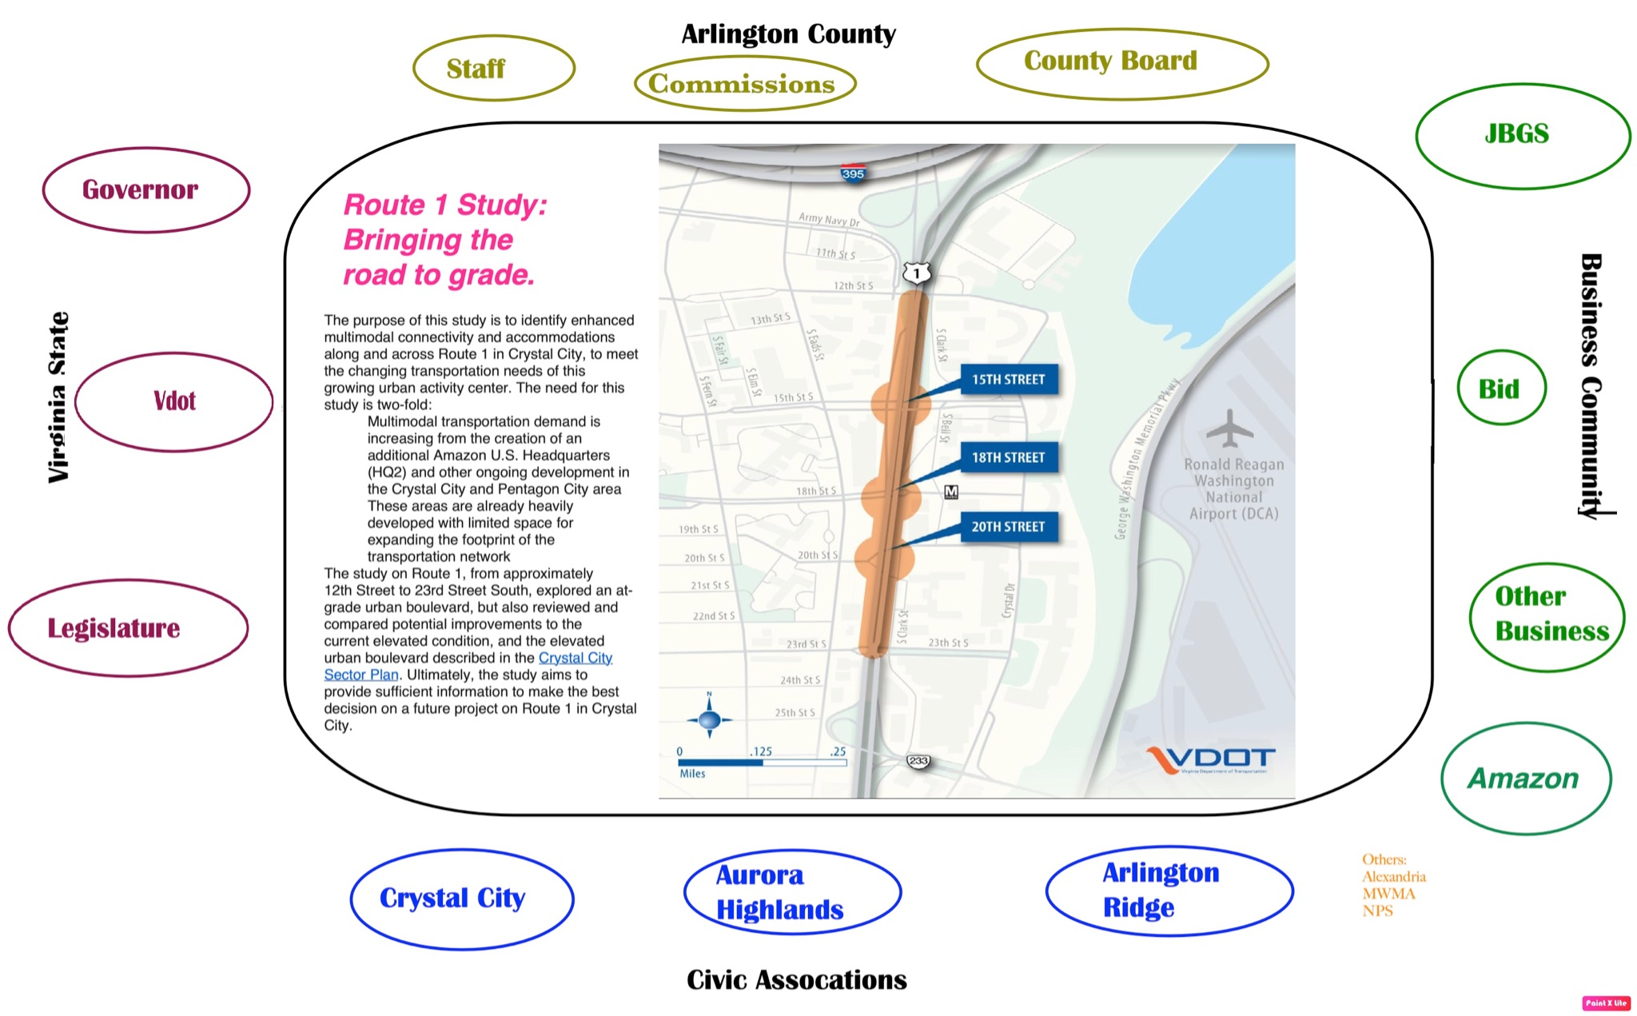

Slide 8
History of Community Engagement
2010 Crystal City Sector Plan: “Jefferson Davis Highway will become an attractive urban boulevard and unifying element of Crystal City. The laneage and capacity of this regional connector (Type F) roadway will be maintained but not expanded. Its environment will be improved with new buildings and streetscapes that address the street. In Crystal City, Jefferson Davis Boulevard will generally have 140’ to 160’ between building faces. Grade separations at 12th, 15th, and 18th Streets will remain, although the plan includes reconfigured, more urban interchange at 15th Street. “
Virginia Agreement with Amazon: The November 2018 MOU between Amazon and the Commonwealth of Virginia includes a commitment by the Commonwealth “to expeditiously evaluate and implement opportunities to improve safety, accessibility, and the pedestrian experience crossing” Route 1. (It does not call for Route 1 to be brought down to grade.)
VDOT Project: Since July 2020, VDOT has taken the lead to examine the feasibility of converting Route 1 to an at-grade or elevated urban boulevard (or improving the existing elevated roadway) from 12th Street S to 23rd Street S. VDOT will then develop appropriate multimodal solutions for Route 1 to meet the community’s transportation needs with the coming of Amazon and other related development.

Slide 9
2010 Crystal City Sector Plan (p.61)
“Jefferson Davis Highway will become an attractive urban boulevard and unifying element of Crystal City. The laneage and capacity of this regional connector (Type F) roadway will be maintained but not expanded. Its environment will be improved with new buildings and streetscapes that address the street. In Crystal City, Jefferson Davis Boulevard will generally have 140’ to 160’ between building faces. Grade separations at 12th, 15th, and 18th Streets will remain, although the plan includes reconfigured, more urban interchange at 15th Street.“
“In later phases, the plan envisions a major reconfiguration of the 15th Street / Jefferson Davis Boulevard interchange. Depending on timing, alignment, and available resources, other, lower-cost alternatives to achieving similar ends could be explored (such as tucking the existing out-board ramps closer to the through lanes) that would still create new development sites.”

Slide 10
Community Engagement
Nov 2019: Livability Framework and Action Plan: “Design and implement better and safer connections across Route 1”
July 2020: VDOT study begins officially
Aug 26, 2020: Working Group meeting #1: innovative ideas to provide Livability 22202 community-based recommendations
Sept 30, 2020: WG meeting #2; BID invited; results of survey
January 11, 2021: Detailed letter Feedback to VDOT on Feasibility Study
Feb 22, 2021: WG meeting #3 with VDOT
Feb 26, 2021: Livability letter to our VA legislators; meeting with Sen Ebbin Aug 16: meeting with VDOT hosted by Rep Lopez Aug 27
March 14, 2021: Detailed letter Feedback to VDOT on Feasibility Study
June 27,2021: Livability press release on why study is incomplete
July 2, 2021: Livability walk around tour with CB member Takis Karantonis
July 21, 2021: CCCA Virtual General Meeting: Update on VDOT Study on Route 1: Why bring it down to grade? Why do the 3 22202 civic associations say the study is “incomplete”?
Sept 29, 2021: Detailed letter Feedback to VDOT on Feasibility Study

Slide 11
VDOT Engagement with Community
July 2020 to Fall 2021: Study begins
mid-October to mid November 2020: MetroQuest Survey
Dec 16, 2020: Public Engagement Meeting (PIM) #1
March 2021: Virtual PIM #2
June 2021: Virtual PIM #3
Sept 2020-June 14, 2021: 4 Route 1 Task Force meetings of stakeholders
August 2021: Phase 1 Draft Report
October 2021: Final Phase 1 Report
November 2021: County staff release concerns parallelling Livability concerns

Slide 12
The Two Alternatives in Proposal

Slide 14
PLEASE INSERT PAM’s TWO SLIDES HERE

Slide 16
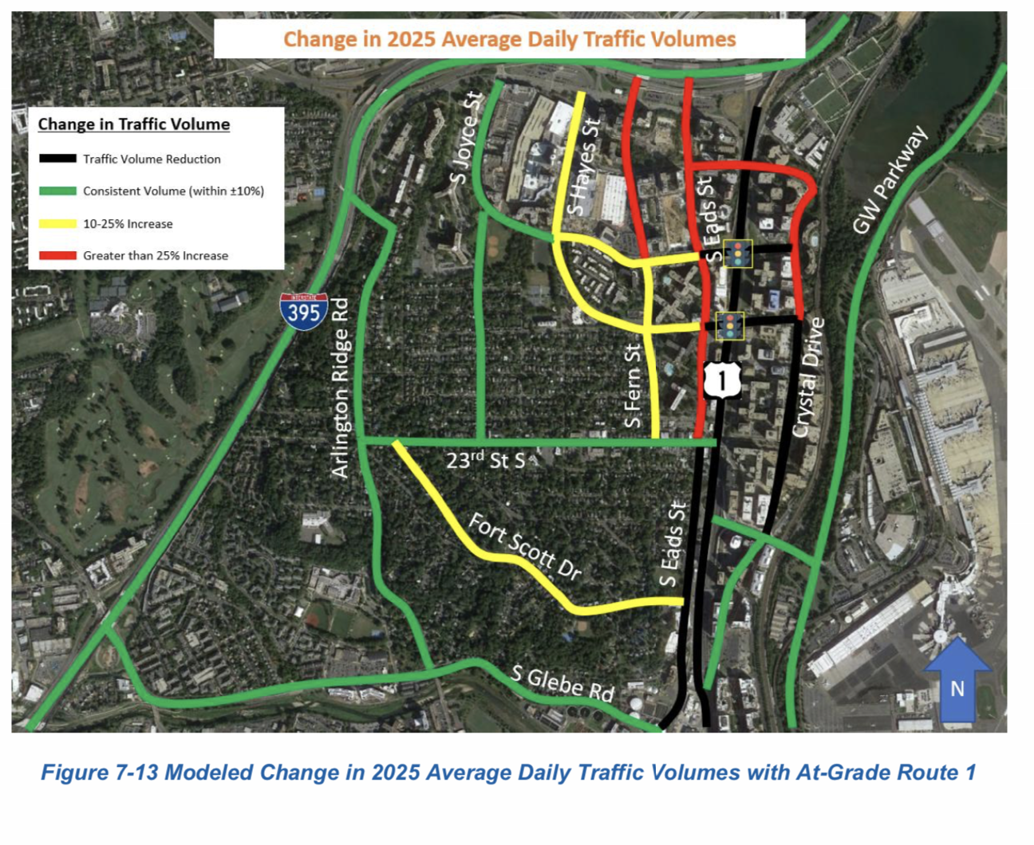

Slide 17
VDOT Rejects Livability Compromise:
15th @ grade; 18th grade-separated
VDOT final Phase 1 report: (p. 89, Section 6.5.4): “The conceptual option to make 15th Street at-grade and keep 18th Street grade separated presented design issues which were not feasible for further conceptual design and analysis. With the continuous change between at-grade and elevated, the profile grades become steeper than allowable per VDOT design guidance. Also, the “roller coaster-like” profile with 12th and 18th streets elevated and 15th and 20th streets at-grade is not conducive to an urban boulevard design.”
Note that VDOT said “Lowering 15th St S only is a possible hybrid option that we may examine later in the study process. The feasibility study can address this potential hybrid option.” (See Appendix H, p. 138)
Livability22202 Rte 1 WG Coordinator Response:
Drivers are going up/over/down 18th Street now, if they are exiting Route 1 northbound at 15th Street S.
Exit ramps already do it; and so does Route 1 in Alexandria.
Design guidance is just guidance, and nothing is "allowable" or "not allowable." All "shoulds," no "shalls." “Design exceptions?" That's the process where designers justify deviating from "shoulds," based on context & project-specific issues.
VDOT uses the wrong design guidance. As a route on the National Highway System, per 23 CFR 625, this project's design is guided by the 7th edition of AASHTO's “A Policy on Geometric Design of Highways and Streets,” aka the "Green Book" https://fhwa.dot.gov/design/standards/190510.pdf
The slower the road, the steeper we can go. The Green Book says: “For a design speed of 30mp (50 km/h), maximum grades generally are in the range of 7 to 12 percent, depending on terrain. …for short grades, less than 500 feet (150 m), in length and for one-way downgrades, the maximum grade may be about one percent steeper than other locations.” (Note VDOT will consider 25mph)

Slide 18
Livability 22202 Concerns and Recommendation about an at-grade 18th & Route 1 Intersection:
VDOT's Route 1 preferred at-grade 18th & Route 1 will:
Slow down buses
Delay ped/bike cross-traffic
Increase traffic on side streets
Cause more crashes, including for pedestrians
Open up only a small amount of land for development (most would be gained through an at-grade 15th, not 18th)
Require a large new space for a bus loop/bus parking for the displaced buses currently on 18th
Rejects the Livability 22202 18th grade-separated proposal based on misinformation
Livability 22202 will likely request that VDOT reconsider the proposed hybrid and perform a thorough analysis of its impact on total project costs, bike/ped safety,land use, and traffic throughput and diversion.

Slide 19
Life has been tough. What County Mental Health resources are available to us?
Carol Layer, Director of the DHS Behavioral Healthcare Division on County Mental Health Services.

